Slide 1
Project 2
Assessing Risk Factors of Bone Fractures Within the First Year of Treatment for Women with Osteoporosis
Presented by:
Derek Rogers
Garrett Drake
Joshua Hudson

Slide 2
Overview
Introduction
Objective Summary
Data Description
Exploratory Data Analysis (EDA)
Objective 1
Objective 2
Conclusion
Appendix

Slide 3
Objective Summary
Objective 1
Modeling approach
Feature Selection Summary
Final Model
Model Interpretation
Objective 2
Summary of approach
Prediction metrics and complexity discussion
Model comparisons
ROC curves
Insights

Slide 4
Data Description
Data taken from the glow_bonemed dataset in the aplore3 R package.
This data set looks to assess risk factors and predict if a woman with osteoporosis will have a bone fracture within the first year of joining the study.
500 subjects
18 variables (Next Slide)
No missing values

Slide 5
Data Description (Cont.)
Variable Details
Response:
Fracture - Any fracture in first year
Explanatory Variables:
bonemed - Bone medications at enrollment
bonemed_fu - Bone medications at follow-up
bonetreat - Bone medications both at enrollment and follow-up
priorfrac - If the patient previously had a fracture
Age (at enrollment)
weight (in kilos)
height (in CM)
BMI (Kg/m^2)
Smoke – Subject is a smoker
Premeno - Menopause before age 45
Momfrac - Mother had hip fracture
Armassist - Arms are needed to stand from a chair
Raterisk - Self-reported risk of fracture
Fracscore - Fracture Risk Score (Composite Risk Score)
Continuous
Numerical
Nominal
Yes/No
Ordinal
1: Less than others of the same age
2: Same as others of the same age
3: Greater than others of the

Slide 6
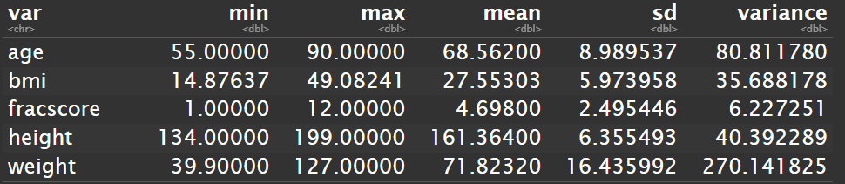
Summary Stats
Continuous
Nominal & Ordinal

Slide 7
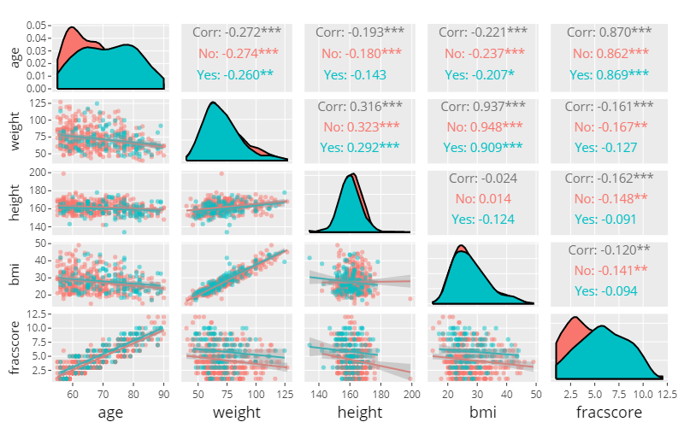
EDA
Relationships – Continuous Variables
Collinearities:
Weight and BMI
Weight and Height
Age and Fracscore

Slide 8
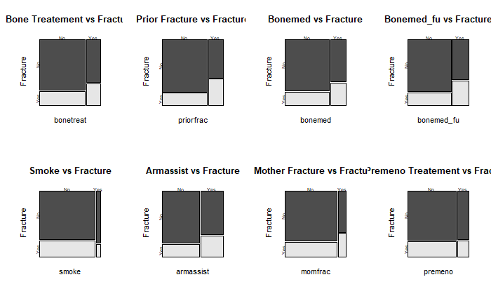
Yes/No Categorical Variable Mosaic Plots

Slide 9
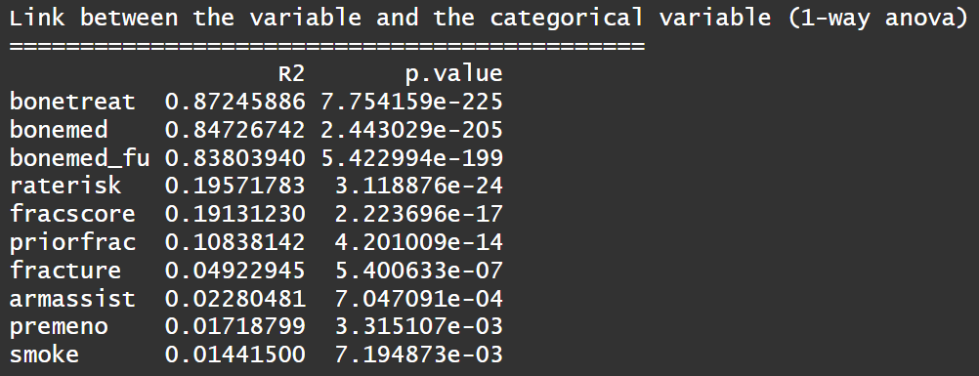
Multiple Correspondence Analysis

Slide 10
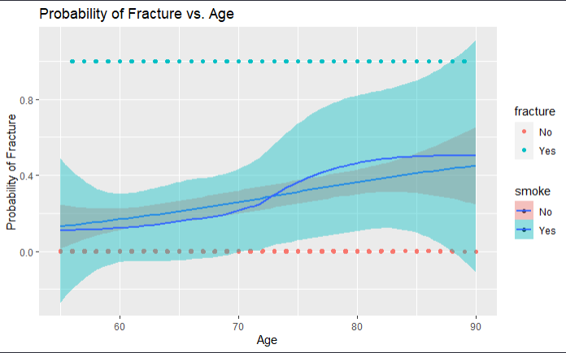
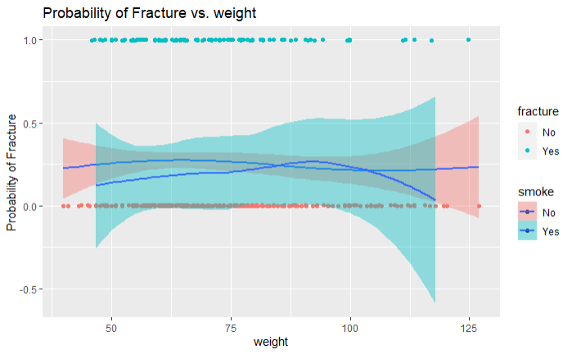
EDA
Relationships – Loess Plots Variables

Slide 11
Objective 1
Modeling approach – Multiple Logistic Regression
Wide open – All variables model:
fracture = priorfrac + age + weight + height + premeno + momfrac + armassist + smoke + raterisk + bonemed + bonemed_fu + bonetreat
Complexity and assumption issues – Variable down selection needed
EDA
Intuition
VIF

Slide 12
Objective 1 (Cont.)
Reduced model – All variables model:
fracture = age + priorfrac + bonemed

Slide 13
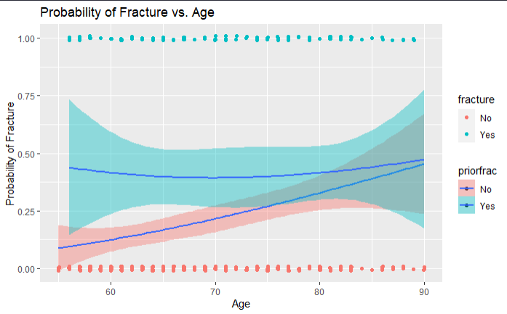
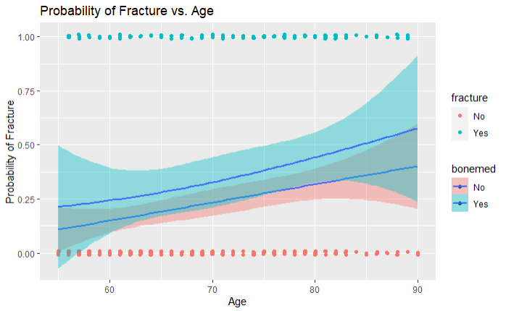
Objective 1
Relationships – Loess Plots for Model Variables

Slide 14
Objective 1 (Cont.)
Model Interpretation:
Holding prior fracture history and bone medication status at the time of enrollment fixed, For any 1-year increase in age, the odds a fracture occurring will increases by a factor of 1.04.
95% CI: (1.01, 1.06)
Holding age and bone medication status at the time of enrollment fixed, the odds a fracture occurring will increases by a factor of 2.2 for those who have had history of fractures as compared to those who have no history with fractures.
95% CI: (1.4, 3.5)
Holding age and prior history of fractures fixed, the odds a fracture occurring will increases by a factor of 1.6 for those who have had bone medication prescribed at the time of enrollment as compared to those who have no history with fractures.
95% CI: (1.0, 2.5)

Slide 15
Objective 2
More complex models where prediction is more important than interpretation
Multiple models for this were built
Complex and LDA models using interactions
Random Forest Model
KNN model on the continuous variables

Slide 16
Complex model using interactions
Began by continuing from EDA looking at possible interactions and important variables.
Relevant EDAs and effects plots to follow with effects plots for this model for some insight
Model is:
fracture = age+ bonetreat + fracscore + priorfrac + bonemed + bonemed_fu + priorfrac:fracscore + age:fracscore + fracscore:bonetreat

Slide 17
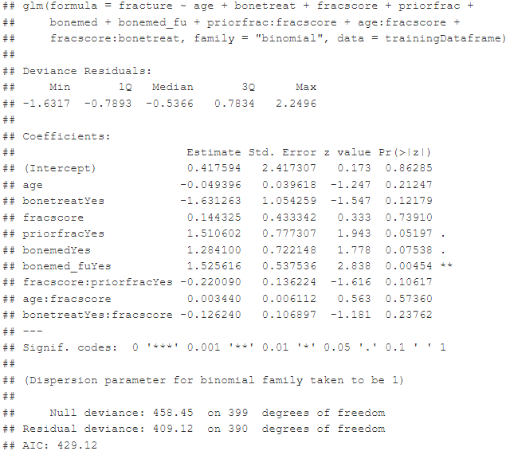
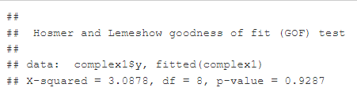
Complex model coefficients and Hosmer and Lemeshow GOF test

Slide 18
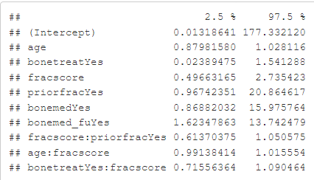
Confidence intervals for complex 1 model

Slide 19
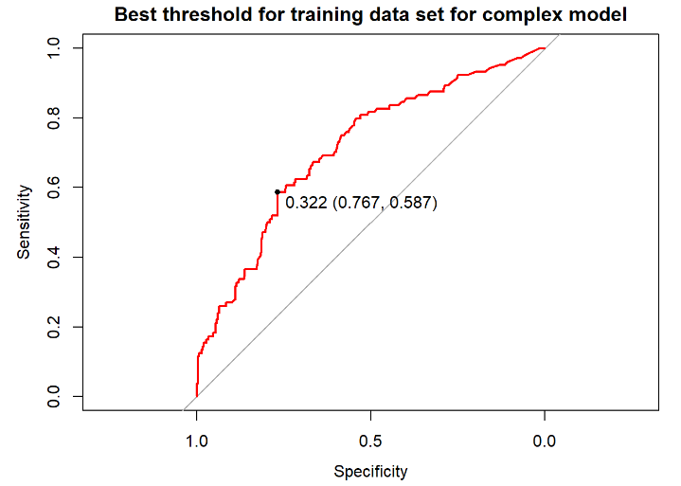
Performance for training set

Slide 20
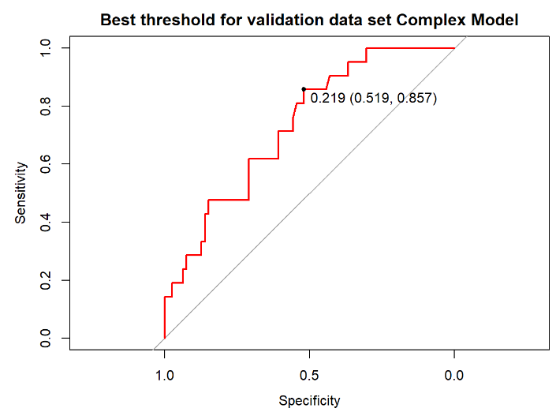
Performance for validation set

Slide 21
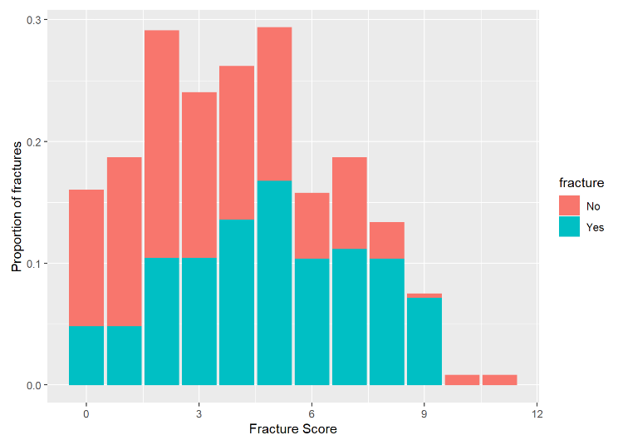
As fracture score increase so does the proportion of getting a fracture

Slide 22
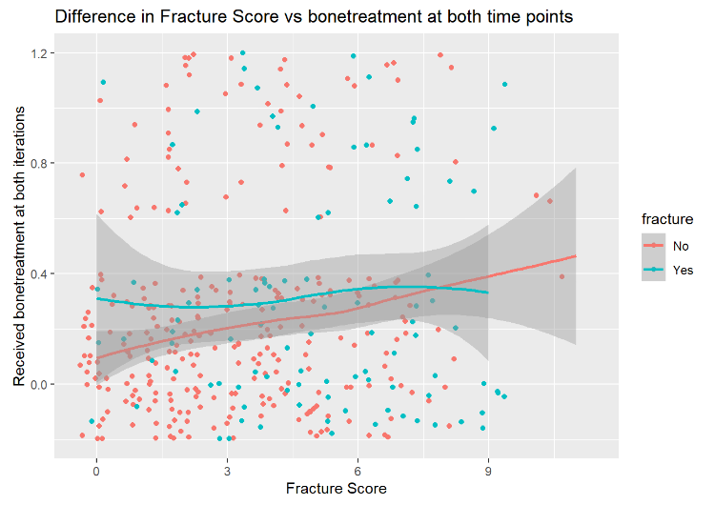
EDA
Notes:
# in bonetreat, i.e. bone meds at both time points, in the no group, there appear to be higher fracture rates with increased fracscore, which would be predicted, i.e. if you received treatment at both times there doesn't appear to be a correlation in fracscore and breaking a bone (fracture), vs the group that did not receive both treatments appears to be a correlation with a higher likelihood correlating to likelihood of fracture

Slide 23
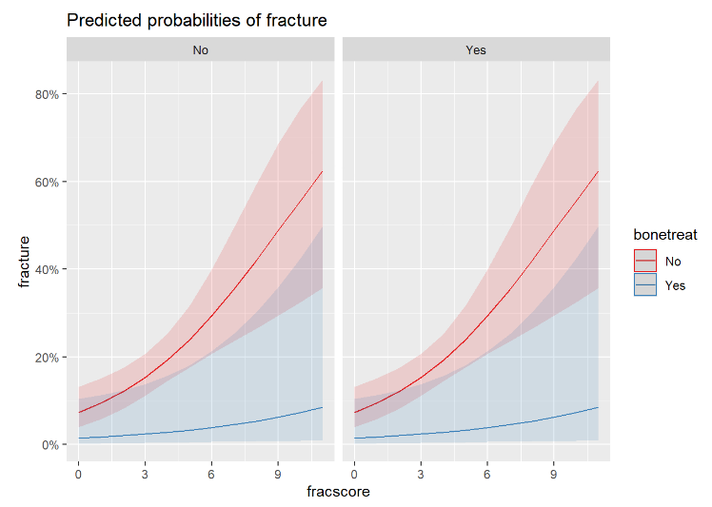
Effects plot of complex model
Notes:
# shows predictive probability of fracturing based on bonetreat and fracscore

Slide 24
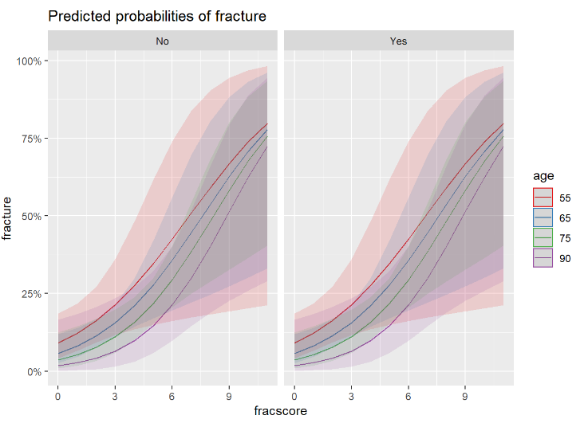
Effects plot of complex model
for age as fracture score increases

Slide 25
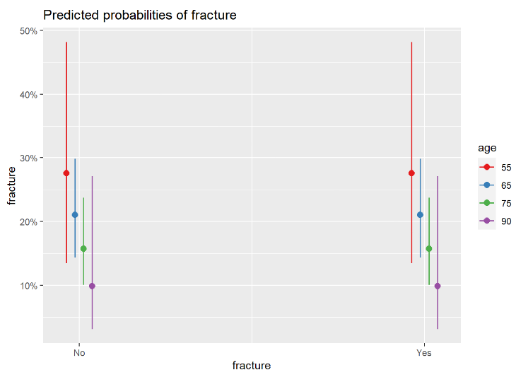
Effects plot of complex model

Slide 26
LDA Model
Began by continuing from EDA looking at possible interactions and important variables, unfortunately there did not appear to be very good separation between any variables, likely due to the low prevalence rate of getting a fracture, measuring the wrong data, or not doing the study long enough.
Relevant EDAs and effects plots to follow with effects plots for this model for some insight
Model is
fracture = (all variables and) - sub_id - phy_id - site_id + priorfrac:fracscore + age:fracscore + fracscore:bonetreat
(phy_id) - physician ID was turned into factor for this model

Slide 27
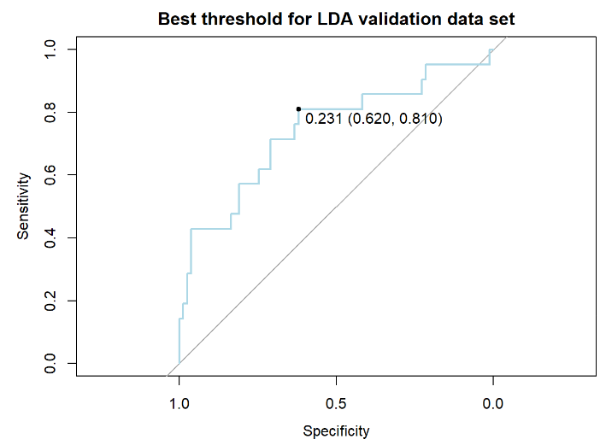
ROC for LDA model

Slide 28
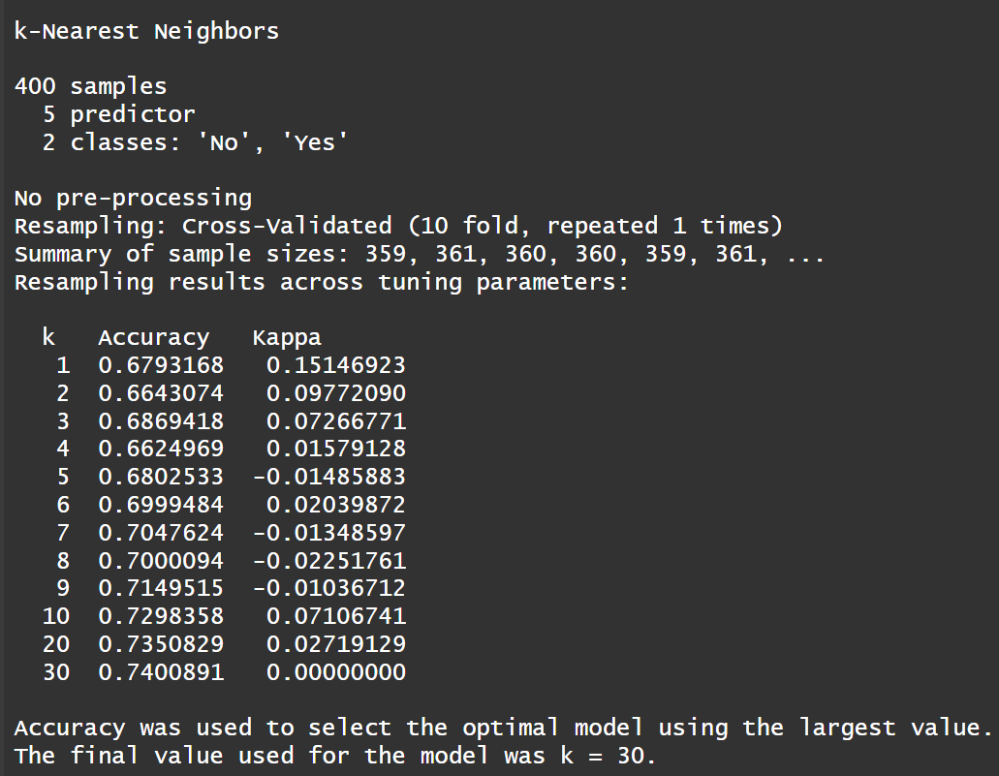
Knn Model
All continuous variables used:
age
weight
height
bmi
Fracscore (0-12 categorical)
All Knn models never performs better than always guessing no fracture (75% accuracy) with the best model only using age.
Notes:
After tinkering it seems the best model only uses the age variable but even that model never got above 73% accuracy

Slide 29
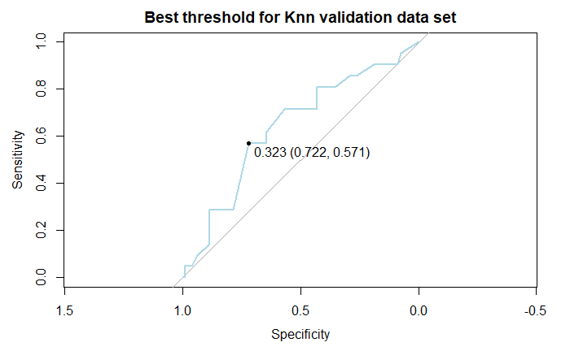
Notes:
After tinkering it seems the best model only uses the age variable

Slide 30
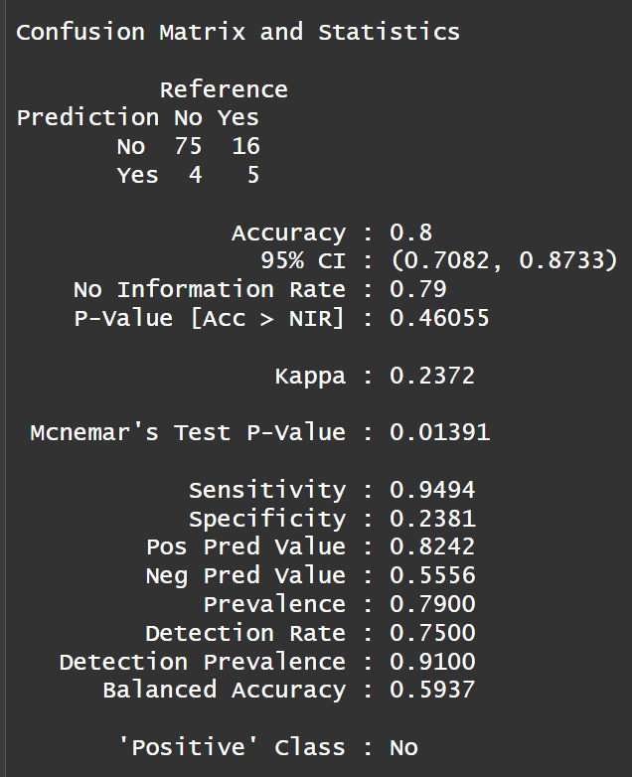
Random Forest Model
Variables used:
priorfrac
age
premeno
momfrac
armassist
smoke
fracscore
bonemed
bonemed_fu

Slide 31
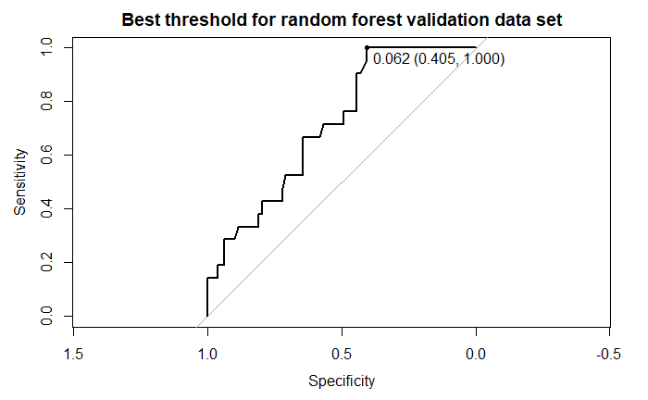
Random Forest Model

Slide 32
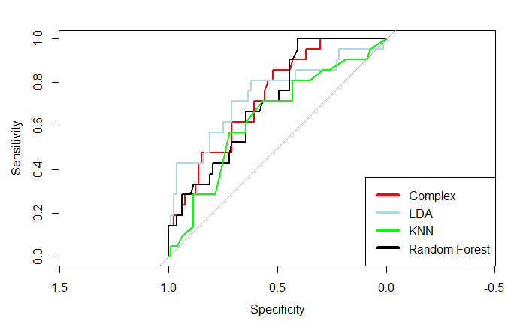
ROC comparing all objective 2 models

Slide 33
Objective 2 model’s performances
Complex model had and AUC-ROC of 0.7312
LDA model had and AUC-ROC of AUC = 0.7414
Random Forest model had and AUC-ROC of AUC = 0.711
KNN model had and AUC-ROC of 0.6389
Best model performance based off of AUC-ROC was the LDA model

Slide 34
Conclusion
The probability of a fracture for a woman with osteoporosis within the first year of joining the study can be modeled using multiple logistic regression and can be sufficiently explained using factors such as age, history of fractures, and bone medication status at the time of enrollment.
LDA model outperformed Random Forest, KNN, and complex models
Performance of models likely suffered due to imbalance in data set (almost 75% had no fracture during the study)

Slide 35
Scope of inference
Attempts were made to find if the study was observational or experimental in nature, because this would affect the scope of inference. Assumptions will be made that this was an observational study, since there is no mention of random sampling or random assignment and there are the almost the same amount of people at each treatment iteration, i.e. initial, follow-up, and taking treatment at both times; therefore it is not safe to generalize to another population beyond this study, nor is it appropriate to make causality claims. If this is a random sample with random assignment it is appropriate to make generalizable claims to similar groups and make causal claims.

Slide 36
Future Recommendations
Given more time, possibly consider further exploration into EDA to see if there are other interactions or polynomials terms that were missed.
Unfortunately there did not appear to be very good separation between any variables, likely due to the low prevalence rate of getting a fracture, measuring the wrong data, or not doing the study long enough.
Research effects plots when using caret package
Measure different variables
Utilize a PCA model for possibly better predictions - see appendix

Slide 37
References
Hosmer, D.W., Lemeshow, S. and Sturdivant, R.X. (2013) Applied Logistic Regression, 3rd ed., New York: Wiley
https://cran.r-project.org/web/packages/aplore3/aplore3.pdf#page=11&zoom=100,132,90

Slide 38
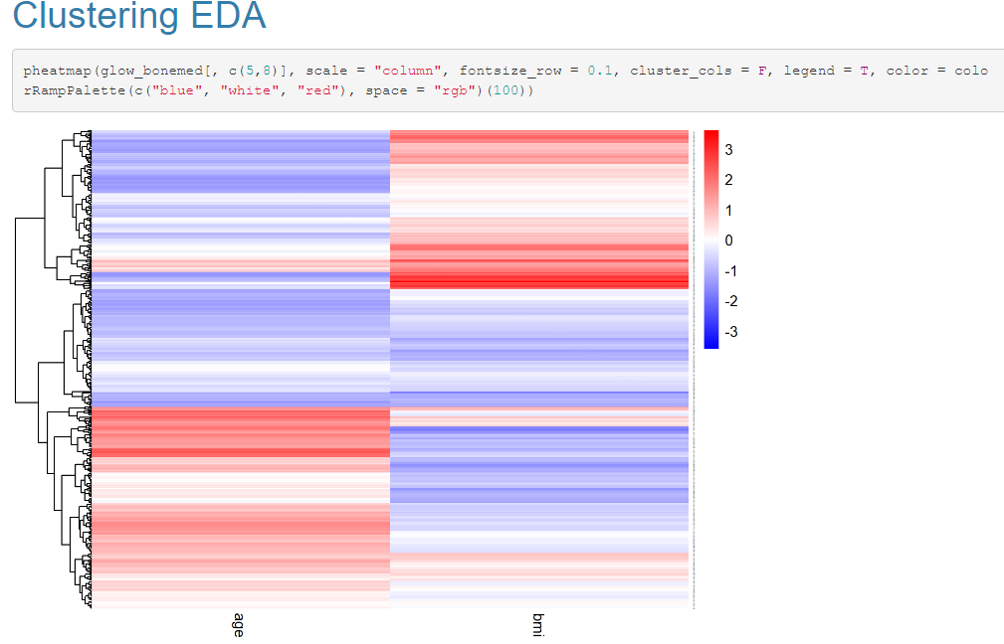
Appendix

Slide 39
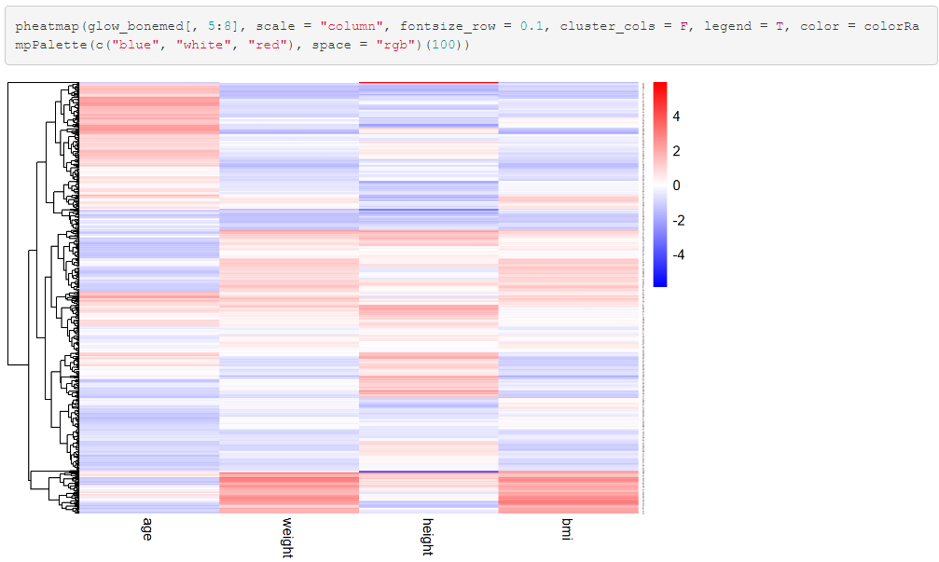
Appendix

Slide 40
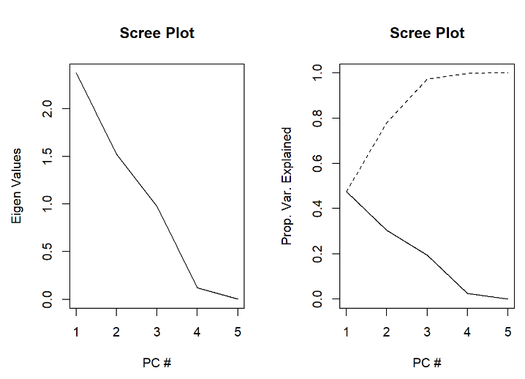
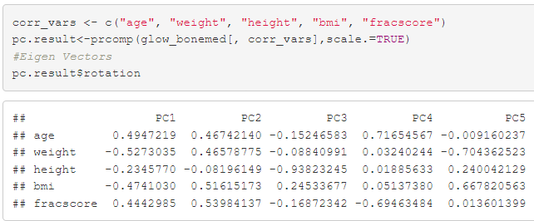
Appendix

Slide 41

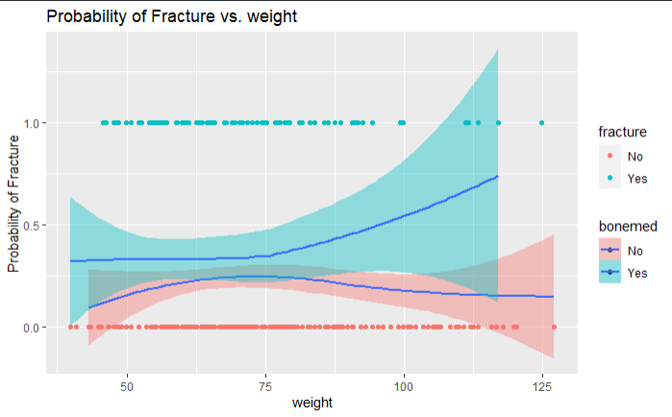
EDA
Relationships – Loess Plots Variables

Slide 42
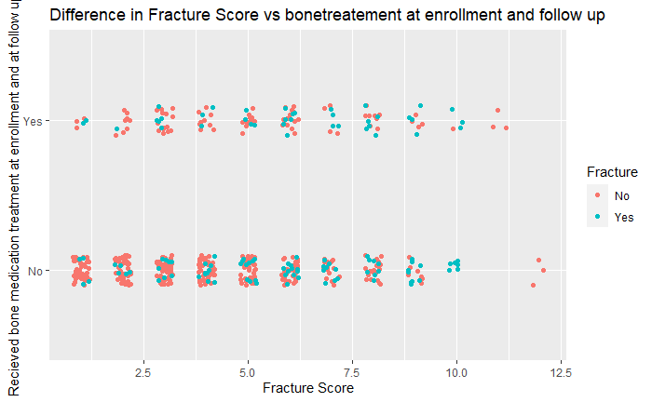
Notes:
# in bonetreat, i.e. bone meds at both time points, in the no group, there appear to be higher fracture rates with increased fracscore, which would be predicted, i.e. if you received treatment at both times there doesn't appear to be a correlation in fracscore and breaking a bone (fracture), vs the group that did not receive both treatments appears to be a correlation with a higher likelihood correlating to likelihood of fracture

Slide 43
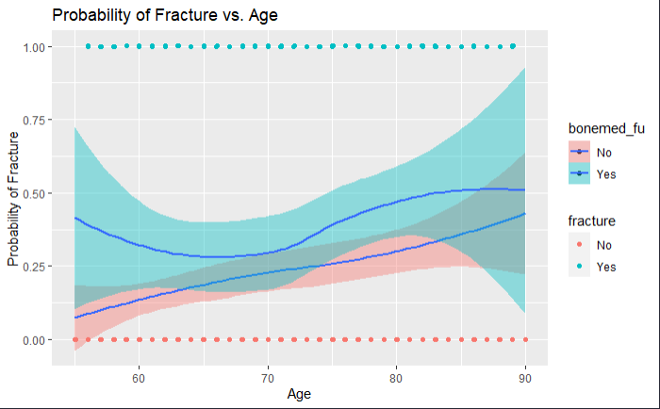
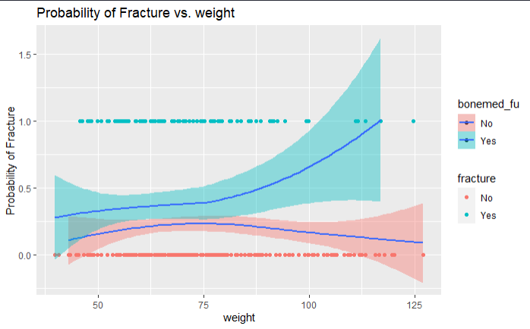
EDA
Relationships – Loess Plots Variables

Slide 44
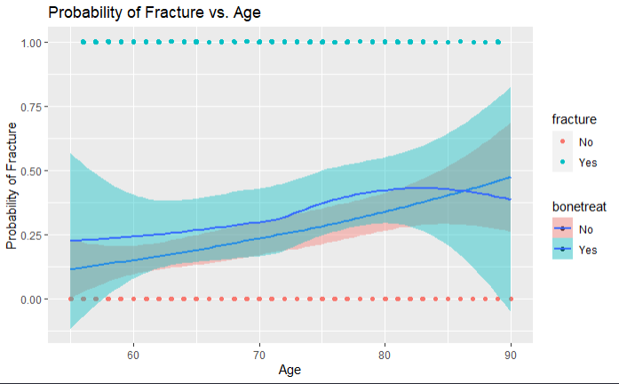
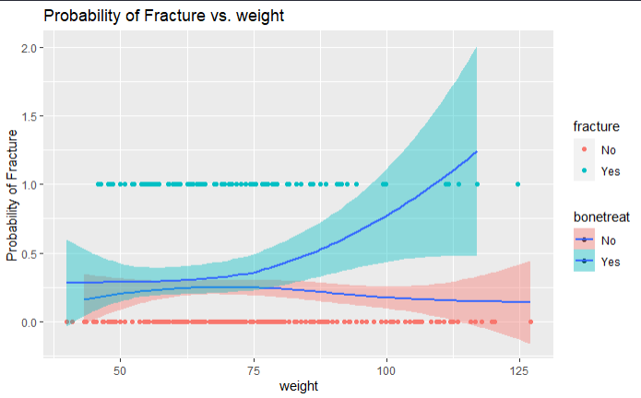
EDA
Relationships – Loess Plots Variables

Slide 45
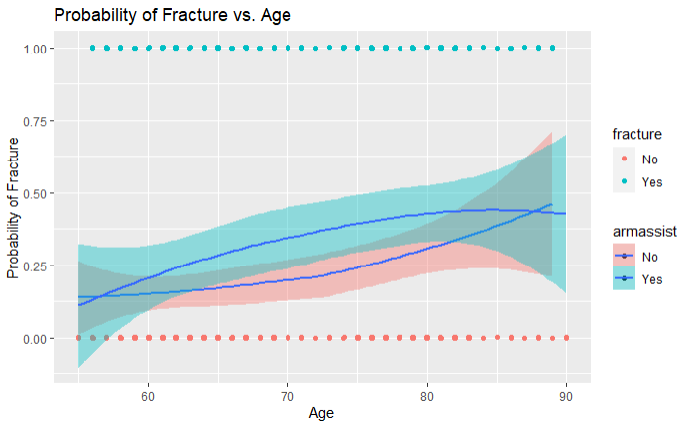
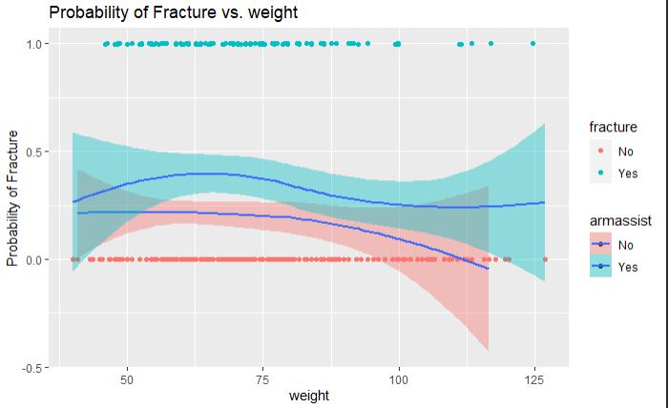
EDA
Relationships – Loess Plots Variables

